Slide 1
Exception handlining
Simeon Angelov

Slide 2
Content
Exception
Checked / Unchecked exceptions / Error
Try-catch block
Method exception handling
User defined exceptions
Facts for the quiz

Slide 3
Exception
A problem that arises during the execution of a program
When an Exception occurs the normal flow of the program is disrupted
When an Exception occurs the program/Application terminates abnormally
Example of exceptions use cases:
File is not found when trying to open a file for reading
A user has enter an invalid number
A communication fail when trying to establish a connection
And many others

Slide 4
Checked / Unchecked exceptions / Error
Checked exceptions
Means that the program should handle these exceptions. Means they cannot be ignored
It is checked (notified) by the compiler at compilation-time
E.g. next is compiled time erroring:
FileInputStream fis = new FileInputStream("B:/myfile.txt");

Slide 5
Checked / Unchecked exceptions / Error
Unchecked exceptions
Occurs on time of execution / running of the program
It does not be formed to be checked/handle at the time of writing the code
All unchecked exceptions are sub-class of RuntimeException class
E.g. when we are trying to access an non existing index in an array:

Slide 6
Checked / Unchecked exceptions / Error
Errors:
These are edge case scenarios when java program cannot handle the execution, but they are not depended on the user/programmers source code
E.g. out of memory error – when the memory is full or stack overflow error

Slide 7




Checked / Unchecked exceptions / Error
Object
Throwlable
Exception
Error
RuntimeException
Any Other checked exception classes
Any sub-cass of runtimeException
is unchecked exception

Slide 8
Checked / Unchecked exceptions / Error
Type | How to recognize | Ok to program to catch ? | Is program required to handle or declare ?
Unchecked exception / Runtime exception | Subclass of RuntimeException | Yes | No
Checked exception | Subclass of Exception BUT not subclass of RuntimeException | Yes | Yes
Error | Subclass of Error | No | No

Slide 9
Checked / Unchecked exceptions / Error
Important methods of Throwlable class
public String getMessage()
public Throwable getCause()
public void printStackTrace()
public StackTraceElement [] getStackTrace()

Slide 10
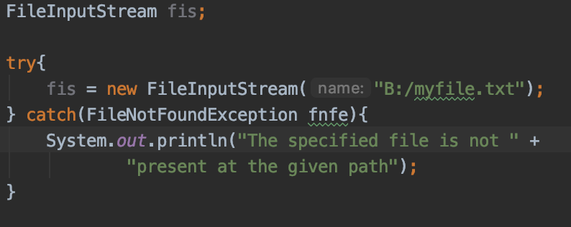


Try-catch block
A way to handle/deal with exceptions (checked and unchecked)
A method catches the exception
Syntax
try {
// Protected code
} catch (ExceptionName e1) {
// Catch block
}
Curly brackets are required
The type of the exception we want to catch

Slide 11
Try-catch block
Multiple try-catch block – catching multiple exception in the block
Syntax:
try {
// Protected code
} catch (ExceptionType1 e1) {
// Catch block
} catch (ExceptionType2 e2) {
// Catch block
}
If an exception occurs in the protected code,
the exception is thrown to the first catch block in the list
- ExceptionType1 in out case
If the data type of the exception thrown matches ExceptionType1, it gets caught there. If not, the exception passes down to the second catch statement

Slide 12
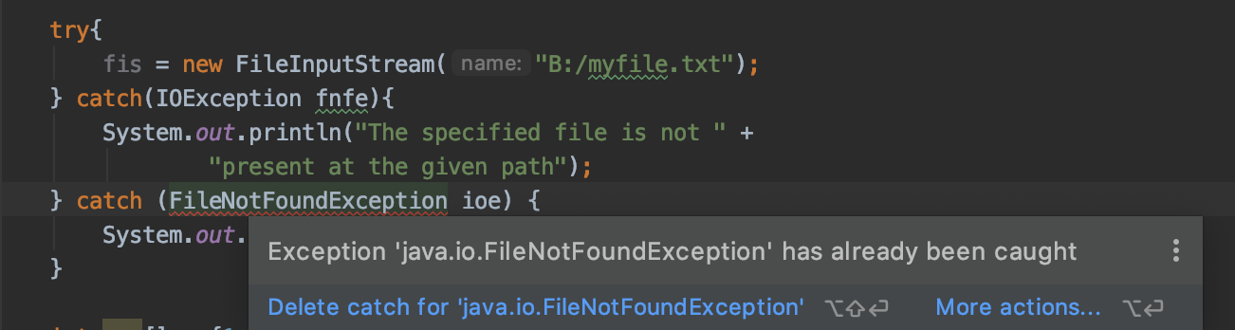
Try-catch block
- ExceptionType2 should be a parent class or ExceptionType1 or another exception type
IOException
FileNotFoundException

Slide 13
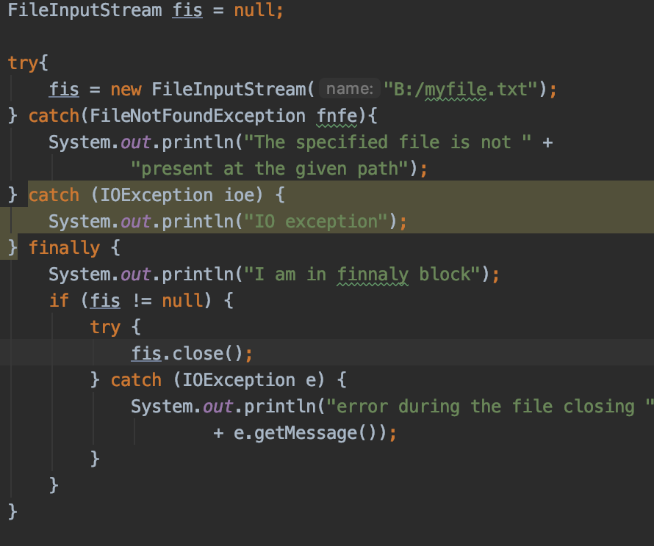
Try-catch block
In try-catch block finally key word could be used
This is the block will be executed at all time – doesn’t matter if exception occurs or not
Used when e.g. we want to close opened resources (connection to BD or file closure and etc .. )
Output is: The specified file is not present at the given path
I am in finnaly block

Slide 14
Try-catch block
Multiple exception types handlining - from java 7
E.g.
catch (IOException|IllegalArgumentException ex) {
System.err.println(ex);
throw ex;
}

Slide 15
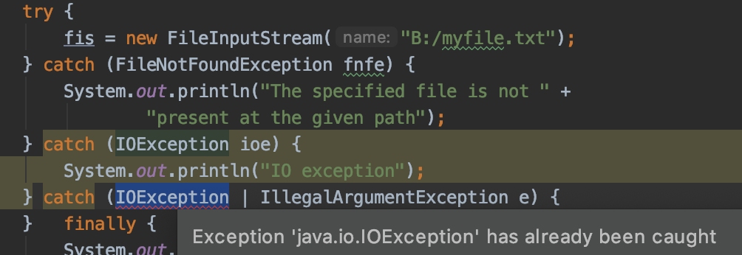
Try-catch block
Compilation error on catching already caught exception

Slide 16
Try-catch block
In multi catch no hierarchy based exceptions (one to be a sub class of another) should be handled

Slide 17
Try-catch block
Remember – first declare catch then finally – not vs
try { // some code
} finally { } catch (Exception e) { }
Compilation error – finally is first

Slide 18
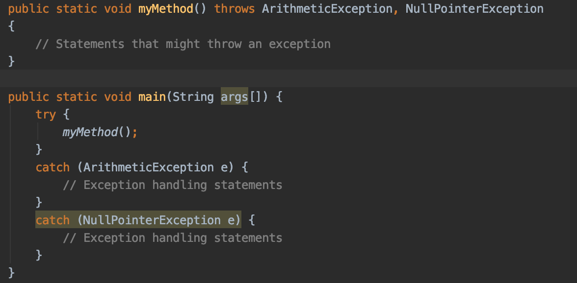
Method exception handling
throws key word
Indicate when a method could throw a particular exception
Syntax:
visibility returnType methodName(args …) throws ExceptionType1, ExceptioTyep2 …

Slide 19
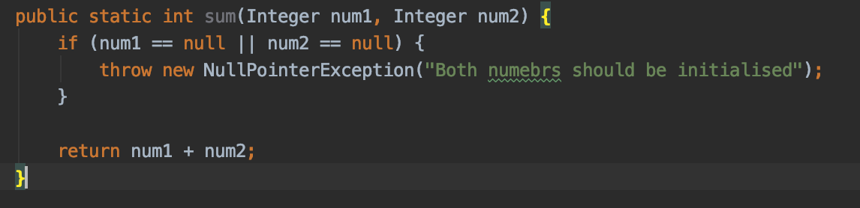
Method exception handling
throw key word
Indicates throwing of a new exception
When the program crates the exception itself and throws it so that the code called that method to take care/handle the exception afterwards

Slide 20
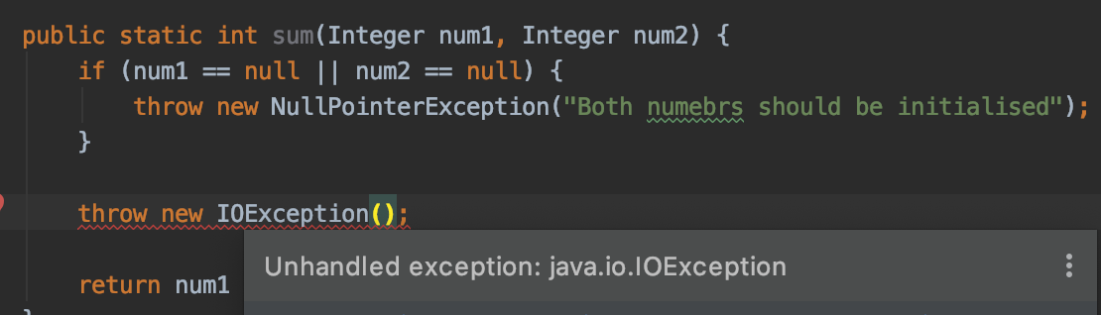
Method exception handling
You cannot throw an exception without being handled (via throws or via try-catch block)
Either surrounded by try-catch or declare IOExeption in method signature via throws key workd

Slide 21
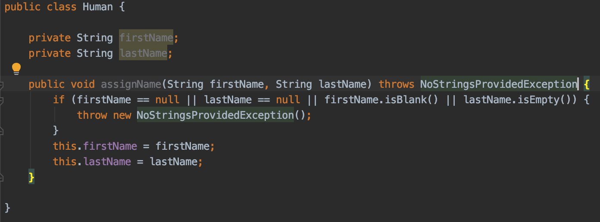
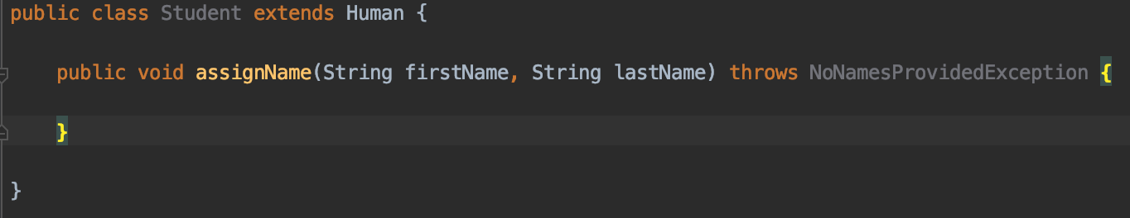
Method exception handling
When overriding a method
the method is allowed to throw fewer checked exceptions than the original method
The method is allowed to throw same checked exception or a sub-class of that exception (not a parent or different exception)
NoStringsProvidedException
NoNamesProvidedException

Slide 22
User Defined Exceptions
A class extending Throwable or any class sub-class of Throwable
For checked exception we needs to extend Exception class
For unchecked exception we needs to extend RuntimeException class

Slide 23
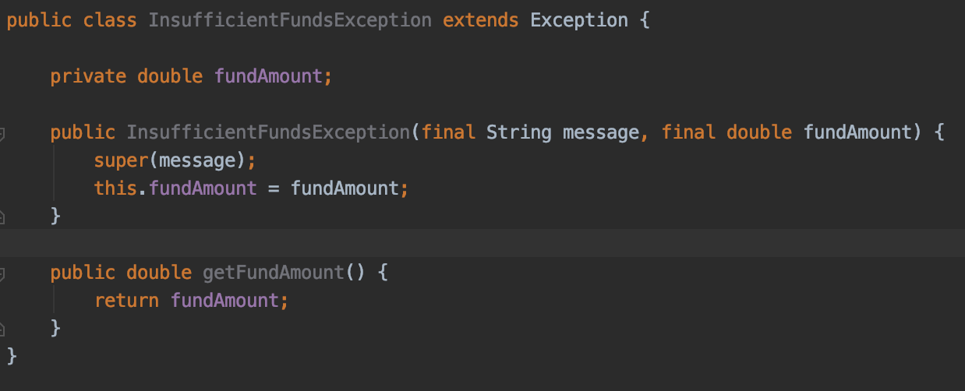
User Defined Exceptions

Slide 24
Common Exception types
ArithmeticException
When try to divide by zero (e.g. int a = 30/0;)
ArrayIndexOutOfBoundsException
When index array out of bounds
ClassCastException
When a cast an exception to a subclass of which it is not an instance
IllegalArgumentException
For illegal argument
NullPointerException
when ref needs to be initlaized but it is null
NumberFormatException

Slide 25
Demo
Javaexception_9
Exercise: Open project exercises_exceptions_9 and go to class BankAccount

Slide 26
Facts for the quiz
Difference between checked and unchecked exceptions
Unchecked also known as runtime exceptions – subclass of RuntimeException
All other exceptions sub-class of Exceptions are checked exceptions
Flow of try-catch-finally block
A try MUST have a catch or finally block. No super class appears in an earlier catch block. Finally block is executed at all time (expect when. There is Error)
Sequence of declaration of try-catch-finally
first declare catch then finally (NOT vs)

Slide 27
Facts about the quiz
On System.exit(0); we don’t go though finally block
Exception is thrown by a programmer or by JVM: e.g. IllegalArgument is by programmer, NullPointerExcetpion is by JVM
Declare methods throwing exception: throws is used in method declaration, throw to crate and throw new exception
Throw vs throws

Slide 28
Facts for the quiz
Overiding about exceptions rules: according to overriding rules, if super class / interface method declares to throw a checked exception, then overriding method of sub class / implementer class has following options:
May not declare to throw any checked exception,
May declare to throw the same checked exception thrown by super class / interface method,
May declare to throw the sub class of the exception thrown by super class / interface method,
Cannot declare to throw the super class of the exception thrown by super class / interface method
Any other?

Slide 29
Questions?
Notes:
Do you have any questions?

Slide 30
Thank You For Your Time

